Slide 1

p-245 Customer personality analysis
Group members :
Ms. Mallu Samhitha Reddy
Mr. Kodati Bhanu Venkata Siva Saiki
Mr. Pannem Leela Krishna
Mr. Rajesh Kumar Sethi
Mr. Jarugubilli Ashok Kumar
Mr. Mohammad Abdul Irfan
Ms. Anupama Sunil Kate

Slide 2
project attributes
People
ID
Products
MntWines
Promotion
NumDealsPurchases
Place
NumWebPurchases
Year Birth
Education
Marital Status
Income
Kidhome
Teenhome
Dt Customer
Recency
Complain
MntFruits
MntMeatProducts
MntFishProducts
MntSweetProducts
MntGoldProds
AcceptedCmp1
AcceptedCmp2
AcceptedCmp3
AcceptedCmp4
AcceptedCmp5
Response
NumCatalogPurchases
NumStorePurchases
NumWebVisitsMonth

Slide 3
Objectives :
Customer personality analysis helps a business to modify its product based on its target customers from different types of customer segments. For example, instead of spending money to market a new product to every customer in the company’s database, a company can analyse which customer segment is most likely to buy the product and then market the product only on that particular segment.

Slide 4
Steps involved :
EDA
Data Cleaning
Clustering
Model Validation
Deployment

Slide 5
EDA :
Exploratory Data Analysis (EDA) is an approach that is used to analyze the data and discover patterns, or check assumptions in data with the help of statistical summaries and graphical representations; It can also help determine if the statistical techniques you are considering for data analysis are appropriate.

Slide 6
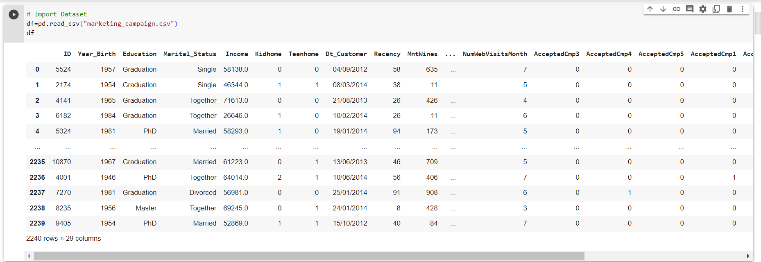
Given data set

Slide 7
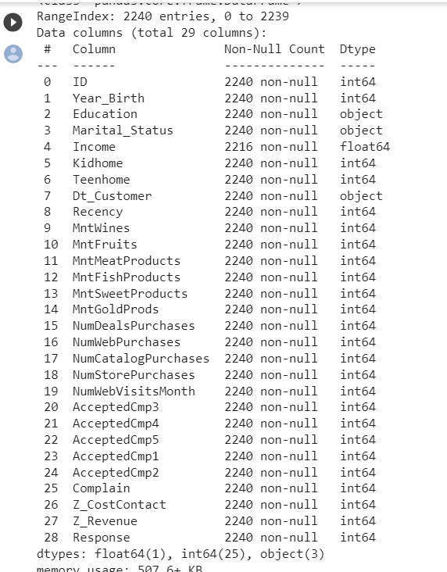

Slide 8
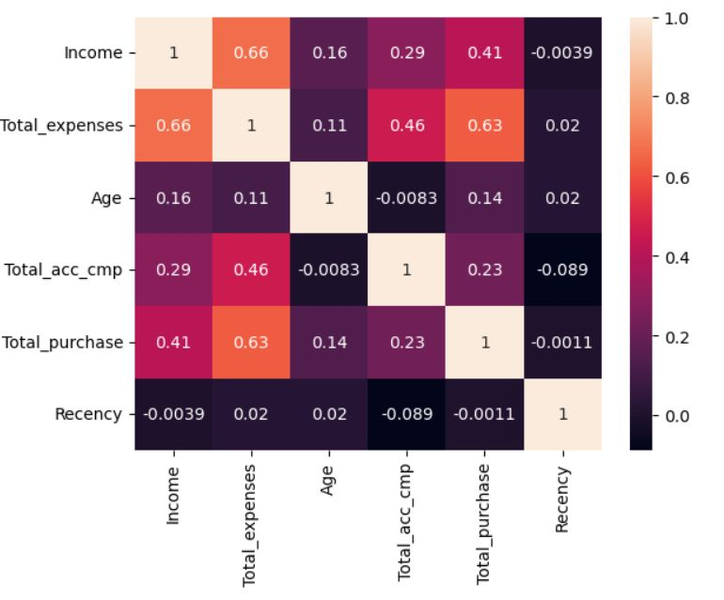
Heat map :

Slide 9
Data cleaning :
Data cleaning is the process of fixing or removing incorrect, or irrelevant data, formatted, duplicate, or incomplete data within a dataset. Also converts data type and handles outliers, removes unwanted data, fix errors and handles missing values.

Slide 10
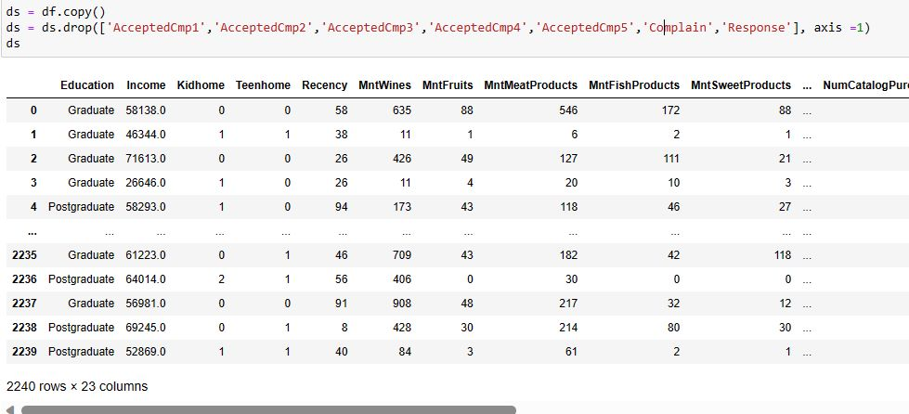

Slide 11
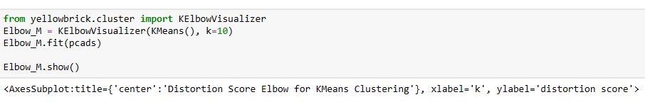
Clustering :
Clustering is used to identify groups of similar objects in datasets with two or more variable quantities.
Clustering methods, such as Hierarchical, Partitioning, Density-based, Model-based, and Grid-based models, assist in grouping data points into clusters. These techniques use various methods to determine the appropriate result for the problem. Clusters are loosely defined as groups of data objects that are more similar to other objects in their cluster than they are to data objects in other clusters.

Slide 12
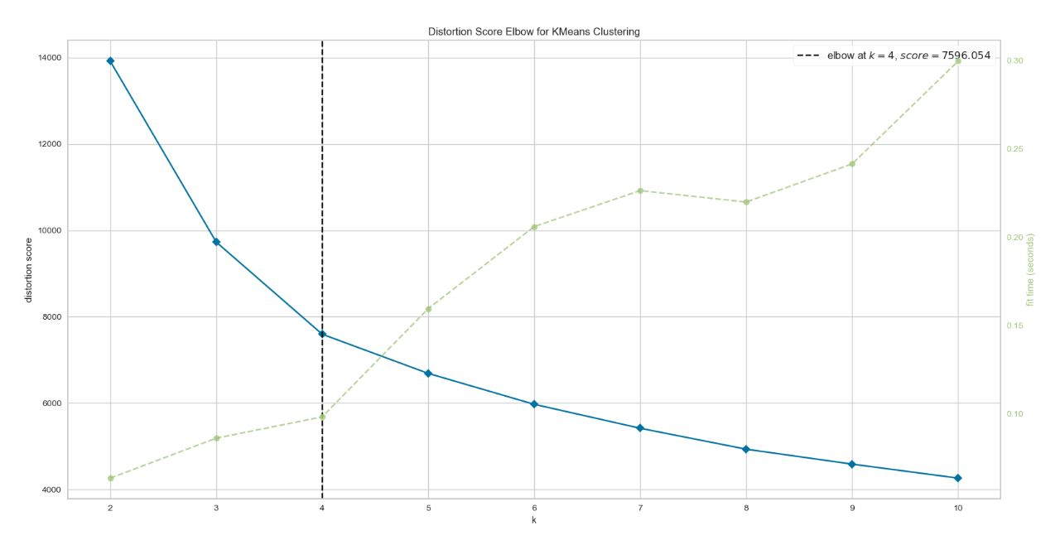

Slide 13
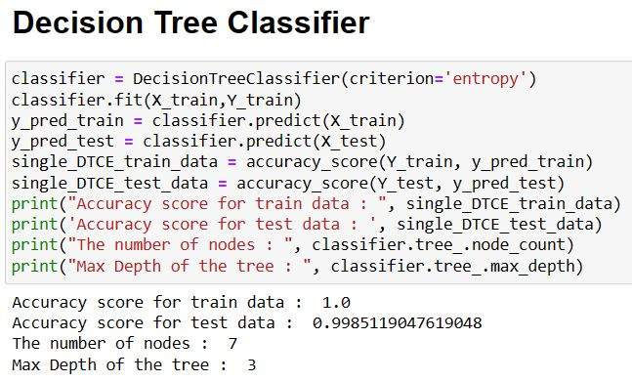
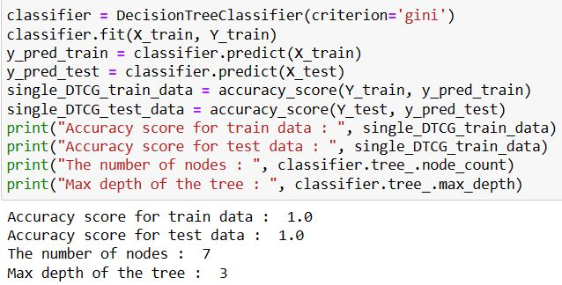
Model validation :
Model validation is the process by which model outputs are (systematically) compared to independent real-world observations to judge the quantitative and qualitative correspondence with reality.
The following are the accuracy scores for different models which we split the train and test for model fitting

Slide 14
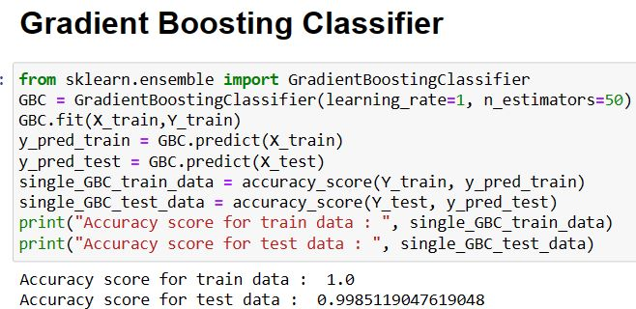

Slide 15
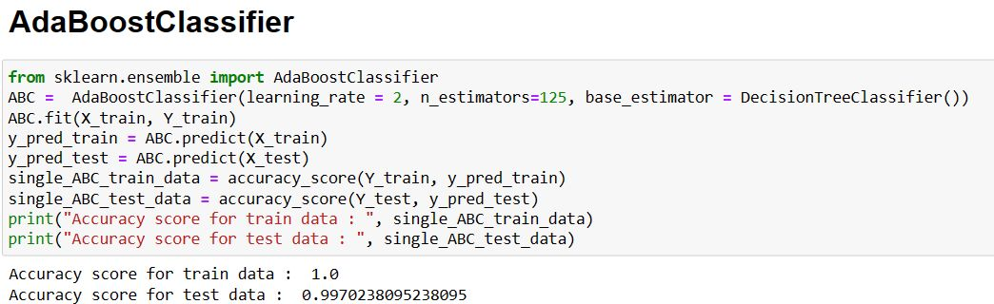

Slide 16
After the model validation based on the accuracy scores compared to others the gradient boosting is the better model and so is used for the following model deployment.

Slide 17
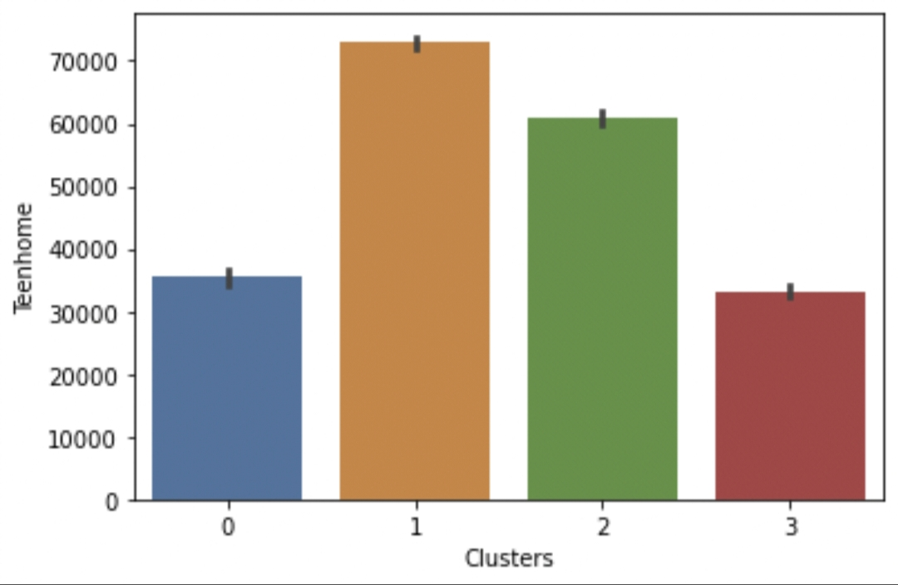
DEPLOYMENT :
Cluster 0 :
-Least Income
-1 kid & few have 1 Teen also
-Graduates & postgraduates but also has most undergraduates than any cluster
-All have partner
Cluster 1 :
-fewer customers but with the highest income
-no kids, few have 1 teen
-graduates & posgraduates
-most of them have partner
CLuster 2:
-Max number of customers & high income
-No kids, few have 1 or 2 teen
-High number of postgraduates & graduates
-Most of them have partner
Clsuter 3 :
-Fewer customers & less income
-1kid & few have 1 Teen also
-Graduates & postgraduates
-All have no partner

Slide 18
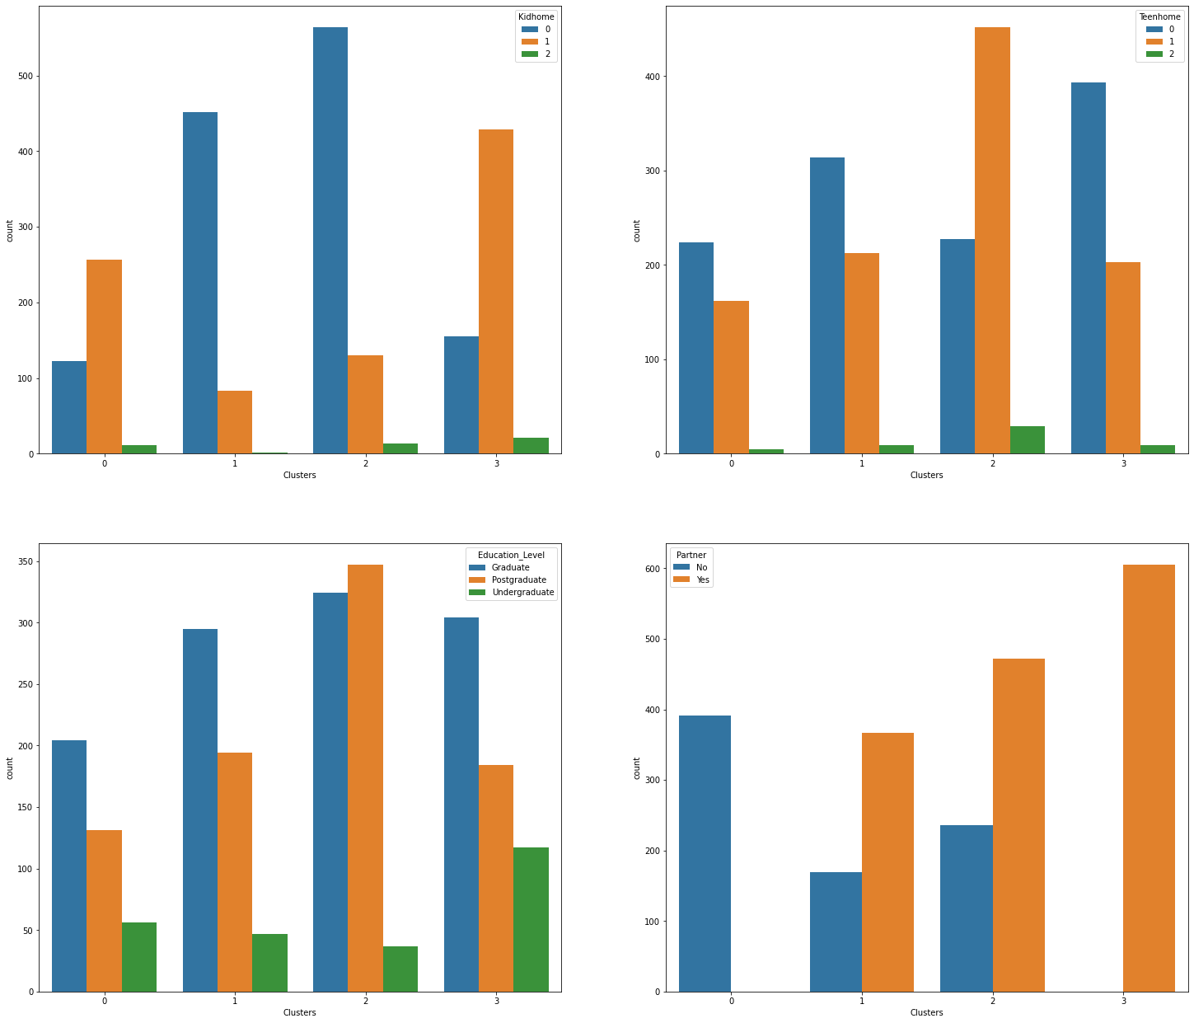

Slide 19
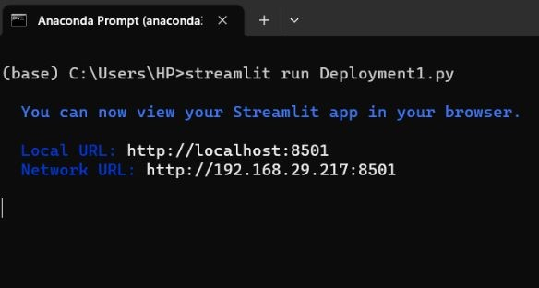

Slide 20
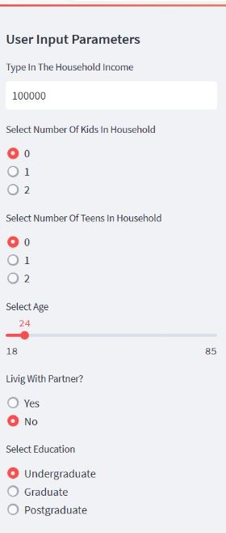
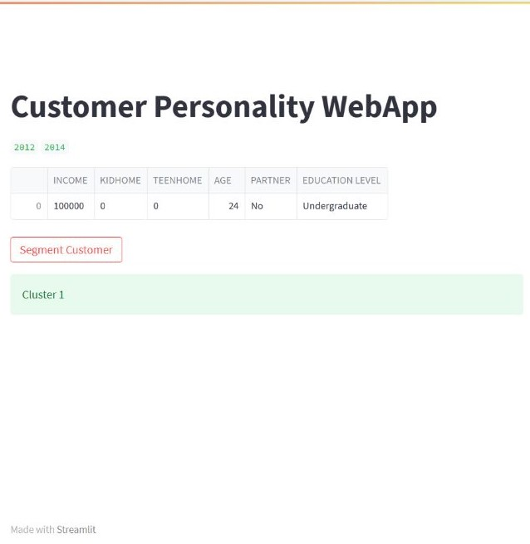

Slide 21
THANK YOU

